Slide 1
NETWORK LAYER
IP Addresses
IPV4/IPV6
Subnetting
Supernetting
Congestion control
Address Mapping : ARP,RARP,ICMP,DHCP

Slide 2
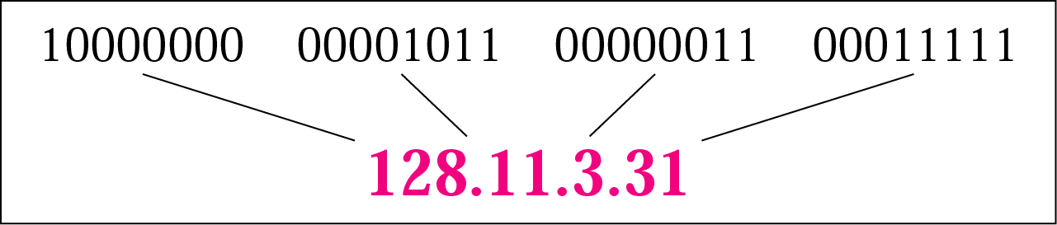
IPv4 Addresses
An IP address is a 32-bit address that uniquely and universally defines the connection of a device
An Address space is the total no. of addresses used by the protocol
The address space of IPv4 is 2³² or 4,294,967,296
Notations
Binary notation: 01110101 10010101 00011101 00000010
Dotted-decimal notation: 117.149.29.2

Slide 3
Example
Change the following IP addresses from binary notation to dotted-decimal notation.
a. 10000001 00001011 00001011 11101111
b. 11111001 10011011 11111011 00001111
We replace each group of 8 bits with its equivalent decimal number and add dots for separation:
a. 129.11.11.239
b. 249.155.251.15

Slide 4

Classful addressing
In classful addressing, the address space is divided into five classes: A, B, C, D, E
A new architecture, called classless addressing was introduced in the mid-1990s

Slide 5
Classful Addressing: Example
Find the class of each address.
a. 00000001 00001011 00001011 11101111
b. 11000001 10000011 00011011 11111111
c. 14.23.120.8
d. 252.5.15.111
Solution
a. The first bit is 0. This is a class A address.
b. The first 2 bits are 1; the third bit is 0. This is a class C address.
c. The first byte is 14; the class is A.
d. The first byte is 252; the class is E.

Slide 6

Classes and Blocks
In classful addressing, a large part of the available addresses were wasted
Class A : large organizations
Class B : mid size organizations
Class C: small organizations
Class D : multicasting
Class E : reserved for future use

Slide 7
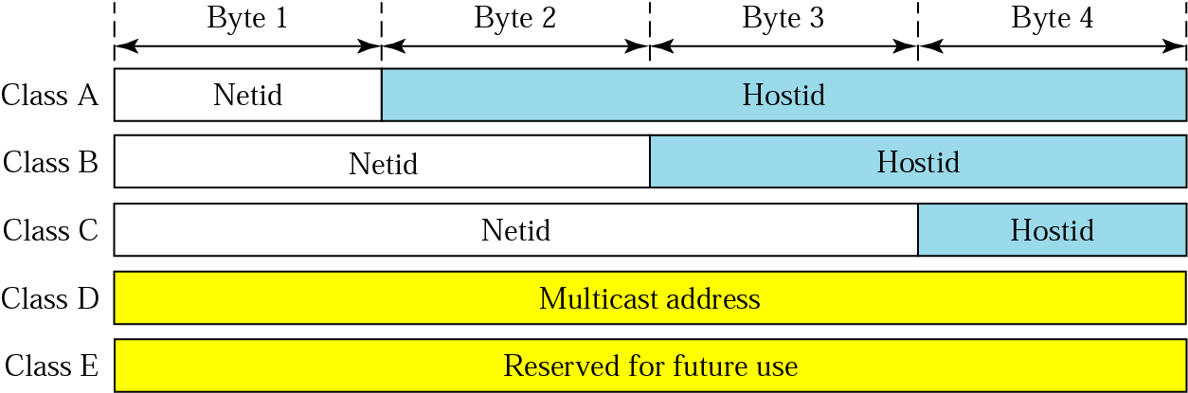
Netid and Hostid
IP address in classes A, B, and C is divided into netid and hostid
Netid: determines the network address
Hostid : determines the host connected to that

Slide 8

Mask: Default Mask
The length of the netid and hostid is predetermined in classful addressing
Default masking
CIDR (Classless Interdomain Routing) notation

Slide 9

Classless addressing
Classful addressing has created many problems
Many ISPs and service users need more addresses
Idea is to have variable-length blocks that belong to no class
Three restrictions on classless address blocks;
  The addresses in a block must be contiguous, one after another
  The number of addresses in a block must be a power of 2
  The first address must be evenly divisible by the number of addresses
Computer Networks
19-<number>

Slide 10
Mask and Address Blocks
In IPv4 addressing, a block of addresses can be defined as x.y.z.t /n in which x.y.z.t defines one of the addresses and the /n defines the mask.
The first address in the block can be found by setting the rightmost 32 − n bits to 0s
The last address in the block can be found by setting the rightmost 32 − n bits to 1s
The number of addresses in the block can be found by using the formula 2^{32−n}
Computer Networks
19-<number>

Slide 11
Classless addressing
Consider a block of addresses
205.16.37.32
205.16.37.33
……………..
205.16.37.47
Total addresses = 16
contiguous
First address is divisible by 16

Slide 12
Example
A block of addresses is granted to an organization ,one of the address is 205.16.37.39/28.What is the first address and last address in the block?
  The binary representation is
  1100110 00010000 00100101 00100111
  If we set 32 − 28 rightmost bits to 0, we get
  11001101 00010000 00100101 00100000
  → 205.16.37.32 (First address)
  If we set 32 − 28 rightmost bits to 1, we get
  11001101 00010000 00100101 00101111
  → 205.16.37.47 (Last address)
  The value of n is 28, which means that number of addresses is 2³²⁻²⁸ or 16

Slide 13

Network Address
The first address in a block is normally not assigned to any device; it is used as the network address that represents the organization to the rest of the world
Hierarchy

Slide 14

Two-Level Hierarchy: No Subnetting
Each address in the block can be considered as a two-level hierarchical structure:
the leftmost n bits (prefix) define the network; the rightmost 32 − n bits define
the host

Slide 15
Subnetting
Divide a large block of addresses into several contiguous groups and assign each group to smaller networks called subnets
Increase the number of 1s in the mask
Computer Networks
19-<number>

Slide 16
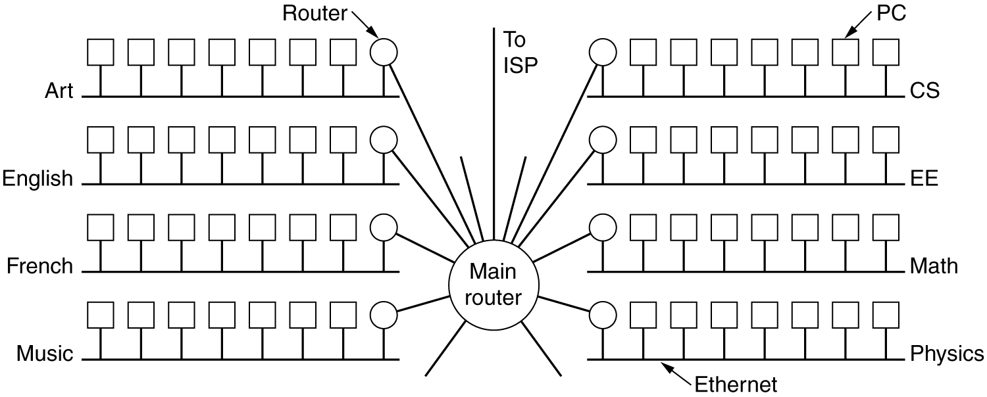
Subnets
A campus network consisting of LANs for various departments.

Slide 17
Subnetting :Example
An organization is given a block which contains 64 addresses. The organization has 3 offices and needs to divide the addresses in to three blocks of 32,16 &16 addresses
First subnet mask n1
32-n1 = 5
n1 = 27
32-n2 = 4
n2=28

Slide 18

Three-Levels of Hierarchy: Subnetting

Slide 19
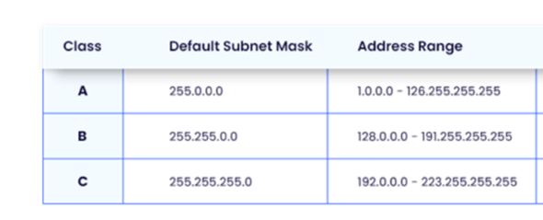
Default subnet mask
A subnet mask is like an IP address that identifies the network and host parts within the original IP address. This identification helps establish specific routes for sending the data to a particular destination. Thus, the subnet mask serves as a tool that the network routers use to match the data packet’s IP address with the destination’s sub-network.

Slide 20
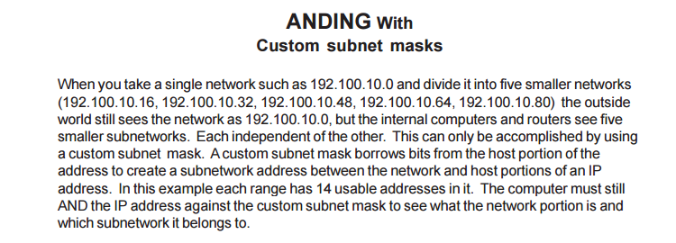

Slide 21
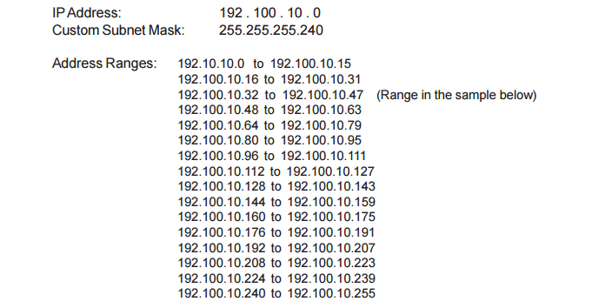
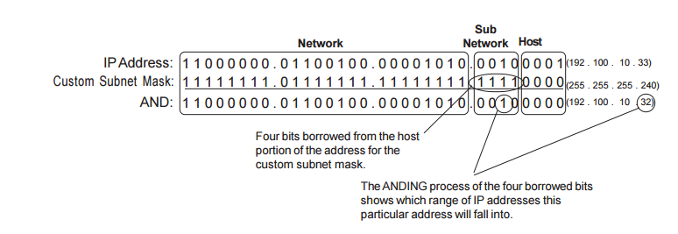

Slide 22
Supernetting
Combine several class C blocks to create a larger range of addresses
Decrease the number of 1s in the mask (/24 → /22 for C addresses)
Computer Networks
19-<number>

Slide 23
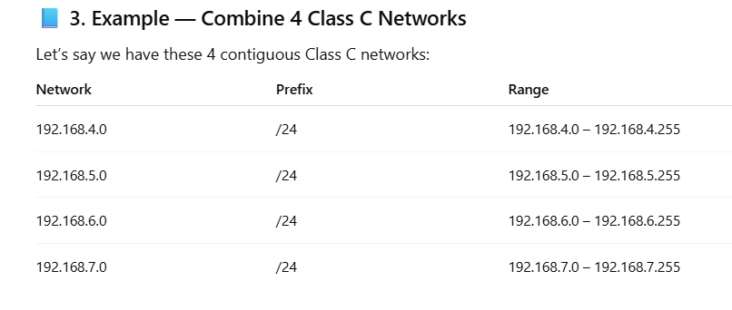

Supernetting

Slide 24
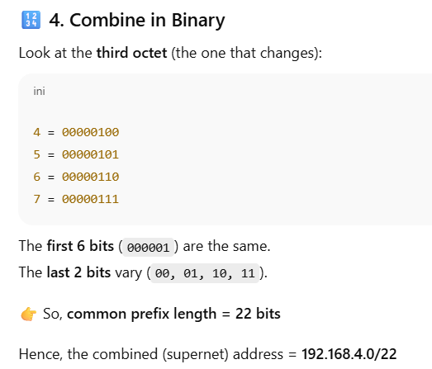

Slide 25
Advantages of Supernetting:
Control and reduce network traffic
Helpful to solve the problem of lacking IP addresses
Minimizes the routing table i.e, it cannot cover a different area of the network when combined and all the networks should be in the same class and all IP should be contiguous

Slide 26
NAT
Network Address Translation (NAT) is a service that operates on a router or edge platform to connect private networks to public networks like the internet. NAT is often implemented at the WAN edge router to enable internet access in core, campus, branch, and co location sites.
With NAT, an organization needs one IP address or one limited public IP address to represent an entire group of devices as they connect outside their network. Port Address Translation (PAT) enables one single IP to be shared by multiple hosts using IP and port address translation.

Slide 27

Figure 19.10 A NAT implementation
19.<number>

Slide 28
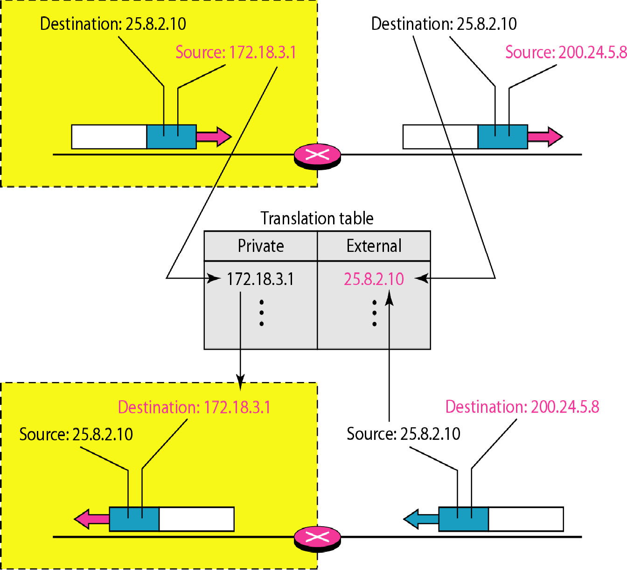
Figure 19.12 NAT address translation
19.<number>

Slide 29
IPV4(Internet Protocol version 4)
The Internet Protocol version 4 (IPv4) is the delivery mechanism used by the TCP/IP protocols
Connectionless and unreliable protocol
A best effort delivery service
For reliability IPV4 must be paired with a protocol such as TCP
Packets in the IPV4 layers are called Datagrams

Slide 30

s
POSITION OF IPV4 in TCP/IP

Slide 31

IPV4 :Datagram format

Slide 32
Version:(4 bits): The Version field keeps track of which version of the protocol the datagram belongs to.
Internet Header Length(IHL 4 bits): IHL, is provided to tell how long the header is, in 32-bit words. The minimum value is 5, which applies when no options are present. The maximum value of this 4-bit field is 15, which limits the header to 60 bytes, and thus the Options field to 40 bytes.
Type-of-Service (8 bits): The Type of service field is one of the few fields that has changed its meaning (slightly) over the years. It was and is still intended to distinguish between different classes of service. Various combinations of reliability and speed are possible. For digitized voice, fast delivery beats accurate delivery. For file transfer, error-free transmission is more important than fast transmission.

Slide 33
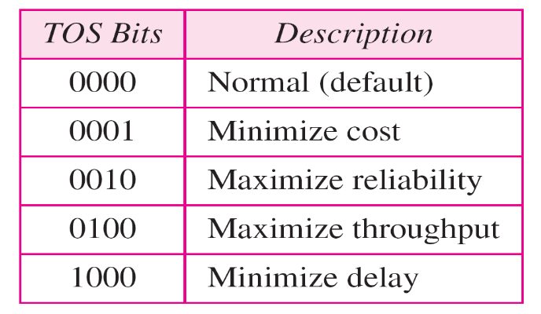

Originally, the 6-bit field contained (from left to right), a three-bit Precedence field and three flags, D, T, and R. The Precedence field was a priority, from 0 (normal) to 7 (network control packet). The three flag bits allowed the host to specify what it cared most about from the set {Delay, Throughput, Reliability}.
Total length(16 bits): The Total length includes everything in the datagram—both header and data. The maximum length is 65,535 bytes. At present, this upper limit is tolerable, but with future gigabit networks, larger data grams may be needed.

Slide 34

Default TOS for Applications

Slide 35
Identifier (16 bits): To have a proper reassembling of fragments , The Identification field is needed to allow the destination host to determine which datagram a newly arrived fragment belongs to. All the fragments of a datagram contain the same Identification value.
Flags(3 bits): First one an unused bit Only two of the bits are currently defined: MF(More Fragments) ,DF(Don't Fragment)
MF(More Fragments) :When a receiving host sees a packet arrive with the MF = 1, it examines the Fragment Offset to see where this fragment is to be placed in the reconstructed packet.
Don't Fragment flag (DF):The Don't Fragment (DF) flag is a single bit in the Flag field that indicates that fragmentation of the packet is not allowed.

Slide 36
Fragment offset: The Fragment offset tells where in the current datagram this fragment belongs.
Time-to-Live (TTL) (8 bits): The Time to live field is a counter used to limit packet lifetimes. It is supposed to count time in seconds, allowing a maximum lifetime of 255 sec. It must be decremented on each hop and is supposed to be decremented multiple times when queued for a long time in a router. In practice, it just counts hops. When it hits zero, the packet is discarded and a warning packet is sent back to the source host..

Slide 37
Protocol (8 bits): The Protocol field tells it which transport process to give it to. TCP is one possibility, but so are UDP and some others.
Header checksum (16 bits): The Header checksum verifies the header only. Such a checksum is useful for detecting errors generated by bad memory words inside a router.

Slide 38


IPv4 Header
Protocol field for higher-level protocol
Computer Networks
20-<number>

Slide 39
IP Destination Address (32 bits): The IP Destination Address field contains a 32-bit binary value that represents the packet destination Network layer host address.
IP Source Address (32 bits): The IP Source Address field contains a 32-bit binary value that represents the packet source Network layer host address.
Options (variable): The Options field is padded out to a multiple of four bytes. Originally, five options were defined The current complete list is now maintained on-line at www.iana.org/assignments/ip-parameters.

Slide 40
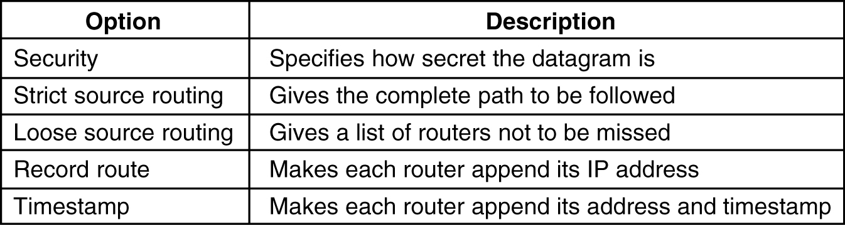
The Security option tells how secret the information is.
The Strict source routing option gives the complete path from source to destination as a sequence of IP addresses. The datagram is required to follow that exact route.

Slide 41
The Loose source routing option requires the packet to traverse the list of routers specified, and in the order specified, but it is allowed to pass through other routers on the way.
The Record route option tells the routers along the path to append their IP address to the option field. This allows system managers to track down bugs in the routing algorithms.
Finally, the Timestamp option is like the Record route option, except that in addition to recording its 32-bit IP address, each router also records a 32-bit timestamp. This option, too, is mostly for debugging routing algorithms.

Slide 42

MTU Maximum transfer unit (MTU)
20.<number>

Slide 43
IPv6

Slide 44
IPv6 address
The use of address space is inefficient
Minimum delay strategies and reservation of resources are required to accommodate real-time audio and video transmission
No security mechanism (encryption and authentication) is provided
IPv6 (IPng: Internetworking Protocol, next generation)
  Larger address space (128 bits)
  Better header format
  New options
  Allowance for extention
  Support for resource allocation: flow label to enable the source to request special handling of the packet
  Support for more security
Computer Networks
20-<number>

Slide 45
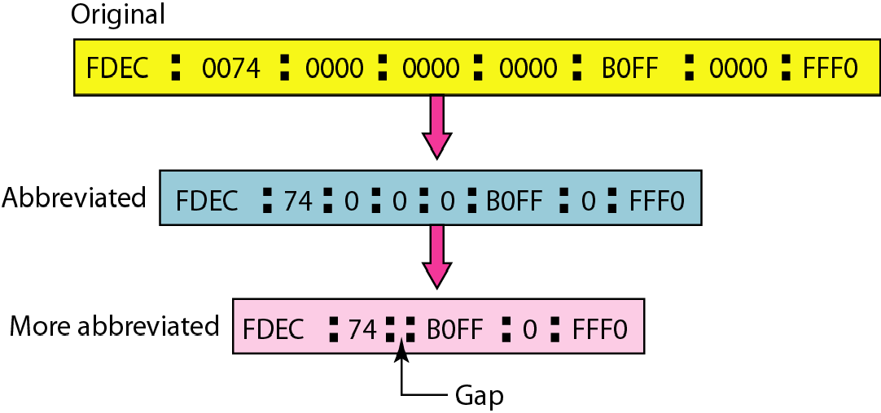
Figure 19.15 Abbreviated IPv6 addresses
19.<number>

Slide 46
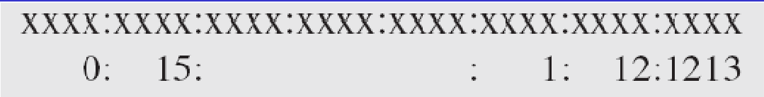
Example 19.11
Expand the address 0:15::1:12:1213 to its original.
This means that the original address is.
19.<number>

Slide 47

IPv6 Datagram
IPv6 defines three types of addresses: unicast, anycast (a group of computers with the same prefix address), and multicast
IPv6 datagram header and payload
Computer Networks
20-<number>

Slide 48

IPv6 Datagram Format
Computer Networks
20-<number>

Slide 49
IPv6 Header
Version: IPv6
Priority (4 bits): the priority of the packet with respect to traffic congestion
Next header (8 bits): to define the header that follows the base header in the datagram
Hop limit: TTL in IPv4
Source address (16 bytes) and destination address (16 bytes): if source routing is used, the destination address field contains the address of the next router
Computer Networks
20-<number>

Slide 50
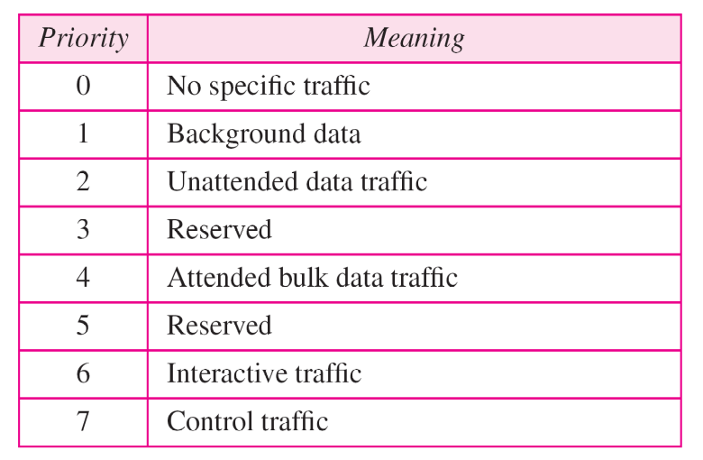
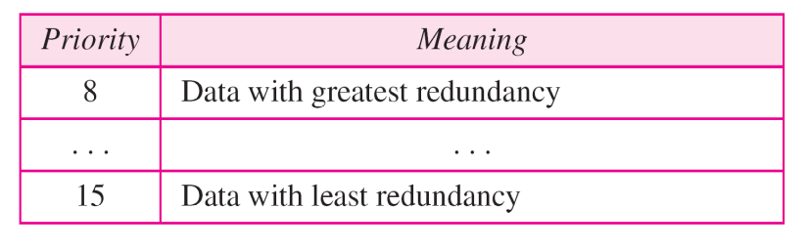
Priority
IPv6 divides traffic into two broad categories: congestion-controlled and noncongestion-controlled
Congestion-controlled traffic
Noncongestion-controlled traffic
Computer Networks
20-<number>

Slide 51
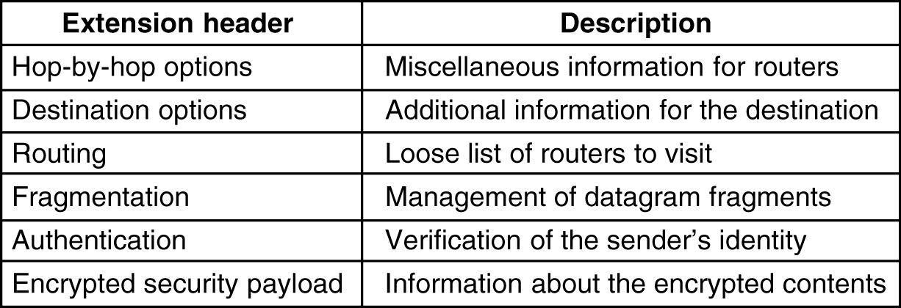
Extension Headers
5-69
IPv6 extension headers.

Slide 52
IPV4/IPV6
IPv4 | IPv6
IPv4 addresses are 32 bit length. | IPv6 addresses are 128 bit length.
IPv4 addresses are binary numbers represented in decimals. | IPv6 addresses are binary numbers represented in hexadecimals.
IPSec support is only optional. | Inbuilt IPSec support.
Fragmentation is done by sender and forwarding routers. | Fragmentation is done only by sender.
No packet flow identification. | Packet flow identification is available within the IPv6 header using the Flow Label field.
Checksum field is available in IPv4 header. | No checksum field in IPv6 header .
Options fields are available in IPv4 header . | No option fields, but IPv6 Extension headers are available

Slide 53
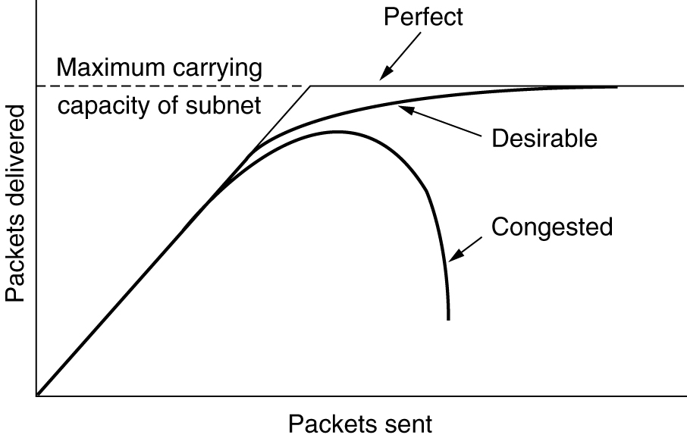
Congestion
When too much traffic is offered, congestion sets in and performance degrades sharply.

Slide 54
Factors that Cause Congestion
Packet arrival rate exceeds the outgoing link capacity.
Insufficient memory to store arriving packets
Bursty traffic
Slow processor

Slide 55
Congestion Control vs Flow Control
Congestion control is a global issue – involves every router and host within the subnet
Flow control – scope is point-to-point; involves just sender and receiver.

Slide 56
Congestion Control Algorithms
General Principles of Congestion Control
Congestion Prevention Policies
Congestion Control in Virtual-Circuit Subnets
Congestion Control in Datagram Subnets

Slide 57
General Principles of Congestion Control
Open loop & closed loop
Open loop include when to accept & when to discard packets, which ones, and making scheduling decisions at various points in the network.
Closed loop based on feedback loop
  Monitor the system detect when and where congestion occurs.
  Pass information to where action can be taken.
  Adjust system operation to correct the problem.

Slide 58
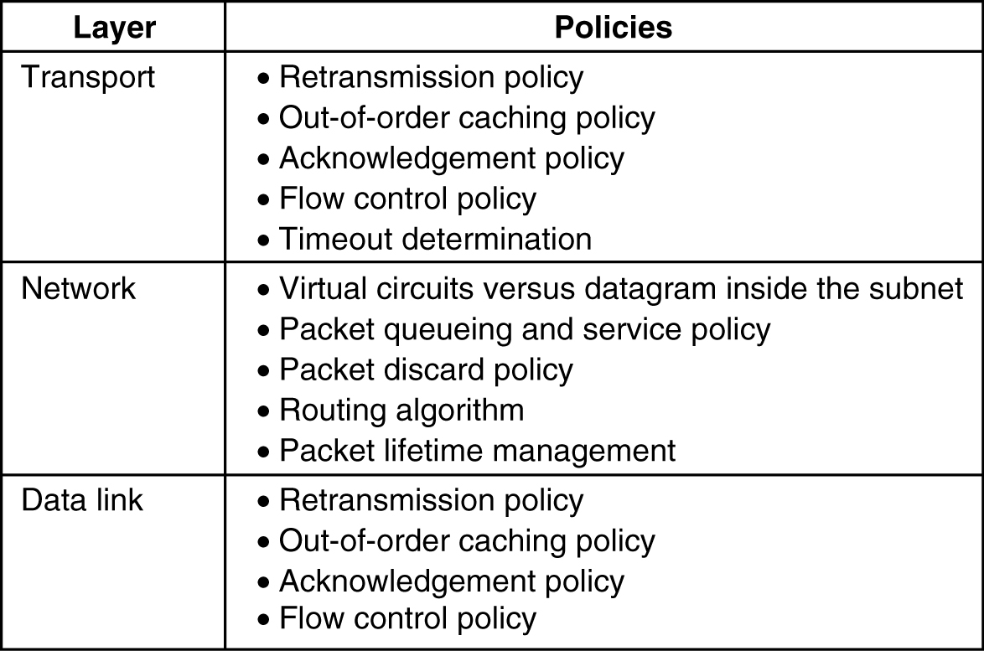
Congestion Prevention Policies
5-26
Policies that affect congestion.

Slide 59
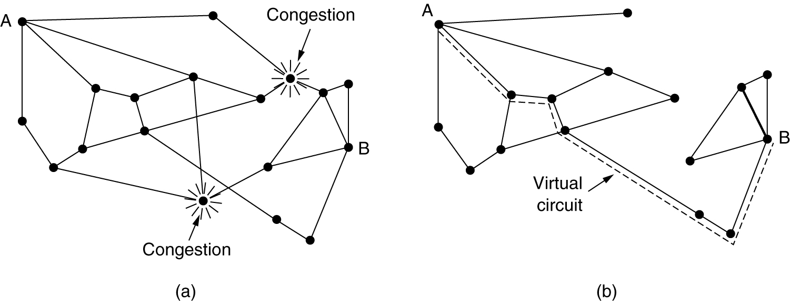
Congestion Control in Virtual-Circuit Subnets
(a) A congested subnet. (b) A redrawn subnet, eliminates congestion and a virtual circuit from A to B.

Slide 60
Congestion Control in Datagram Subnets
Warning Bit
Choke packet
Hop-by-Hop Choke packet
Load Shedding
Jitter Control

Slide 61
Warning Bit
A special bit in the packet header is set by the router to warn the source when congestion is detected.
The bit is copied and piggy-backed on the ACK and sent to the sender.
The sender monitors the number of ACK packets it receives with the warning bit set and adjusts its transmission rate accordingly.

Slide 62
Source based approach
Warning bit
  Output line in warning state
    Warning bit set in header
    Destination copies bit into next ack
    Source cuts back traffic
  Algorithm at source
    As long as warning bits arrive: reduce traffic
    Less warning bits: increase traffic
  Problems
    voluntary action of host!
    correct source selected?
  Used in
    DecNet
    Frame relay
Network layer - congestion

Slide 63
Choke Packet
A more direct way of telling the source to slow down.
A choke packet is a control packet generated at a congested node and transmitted to restrict traffic flow.
The source, on receiving the choke packet must reduce its transmission rate by a certain percentage.
An example of a choke packet is the ICMP Source Quench Packet.

Slide 64
Source based approach
Choke packet
  In case of overload: router sends choke packet to host causing the overload
  Host receiving choke packet
    reduces traffic to the specified destination
    ignores choke packets for a fixed interval
    new choke packets during next listening interval?
      Yes: reduce traffic
      No: increase traffic
  Problems:
    voluntary action of host!
    correct host selected?
Network layer - congestion

Slide 65
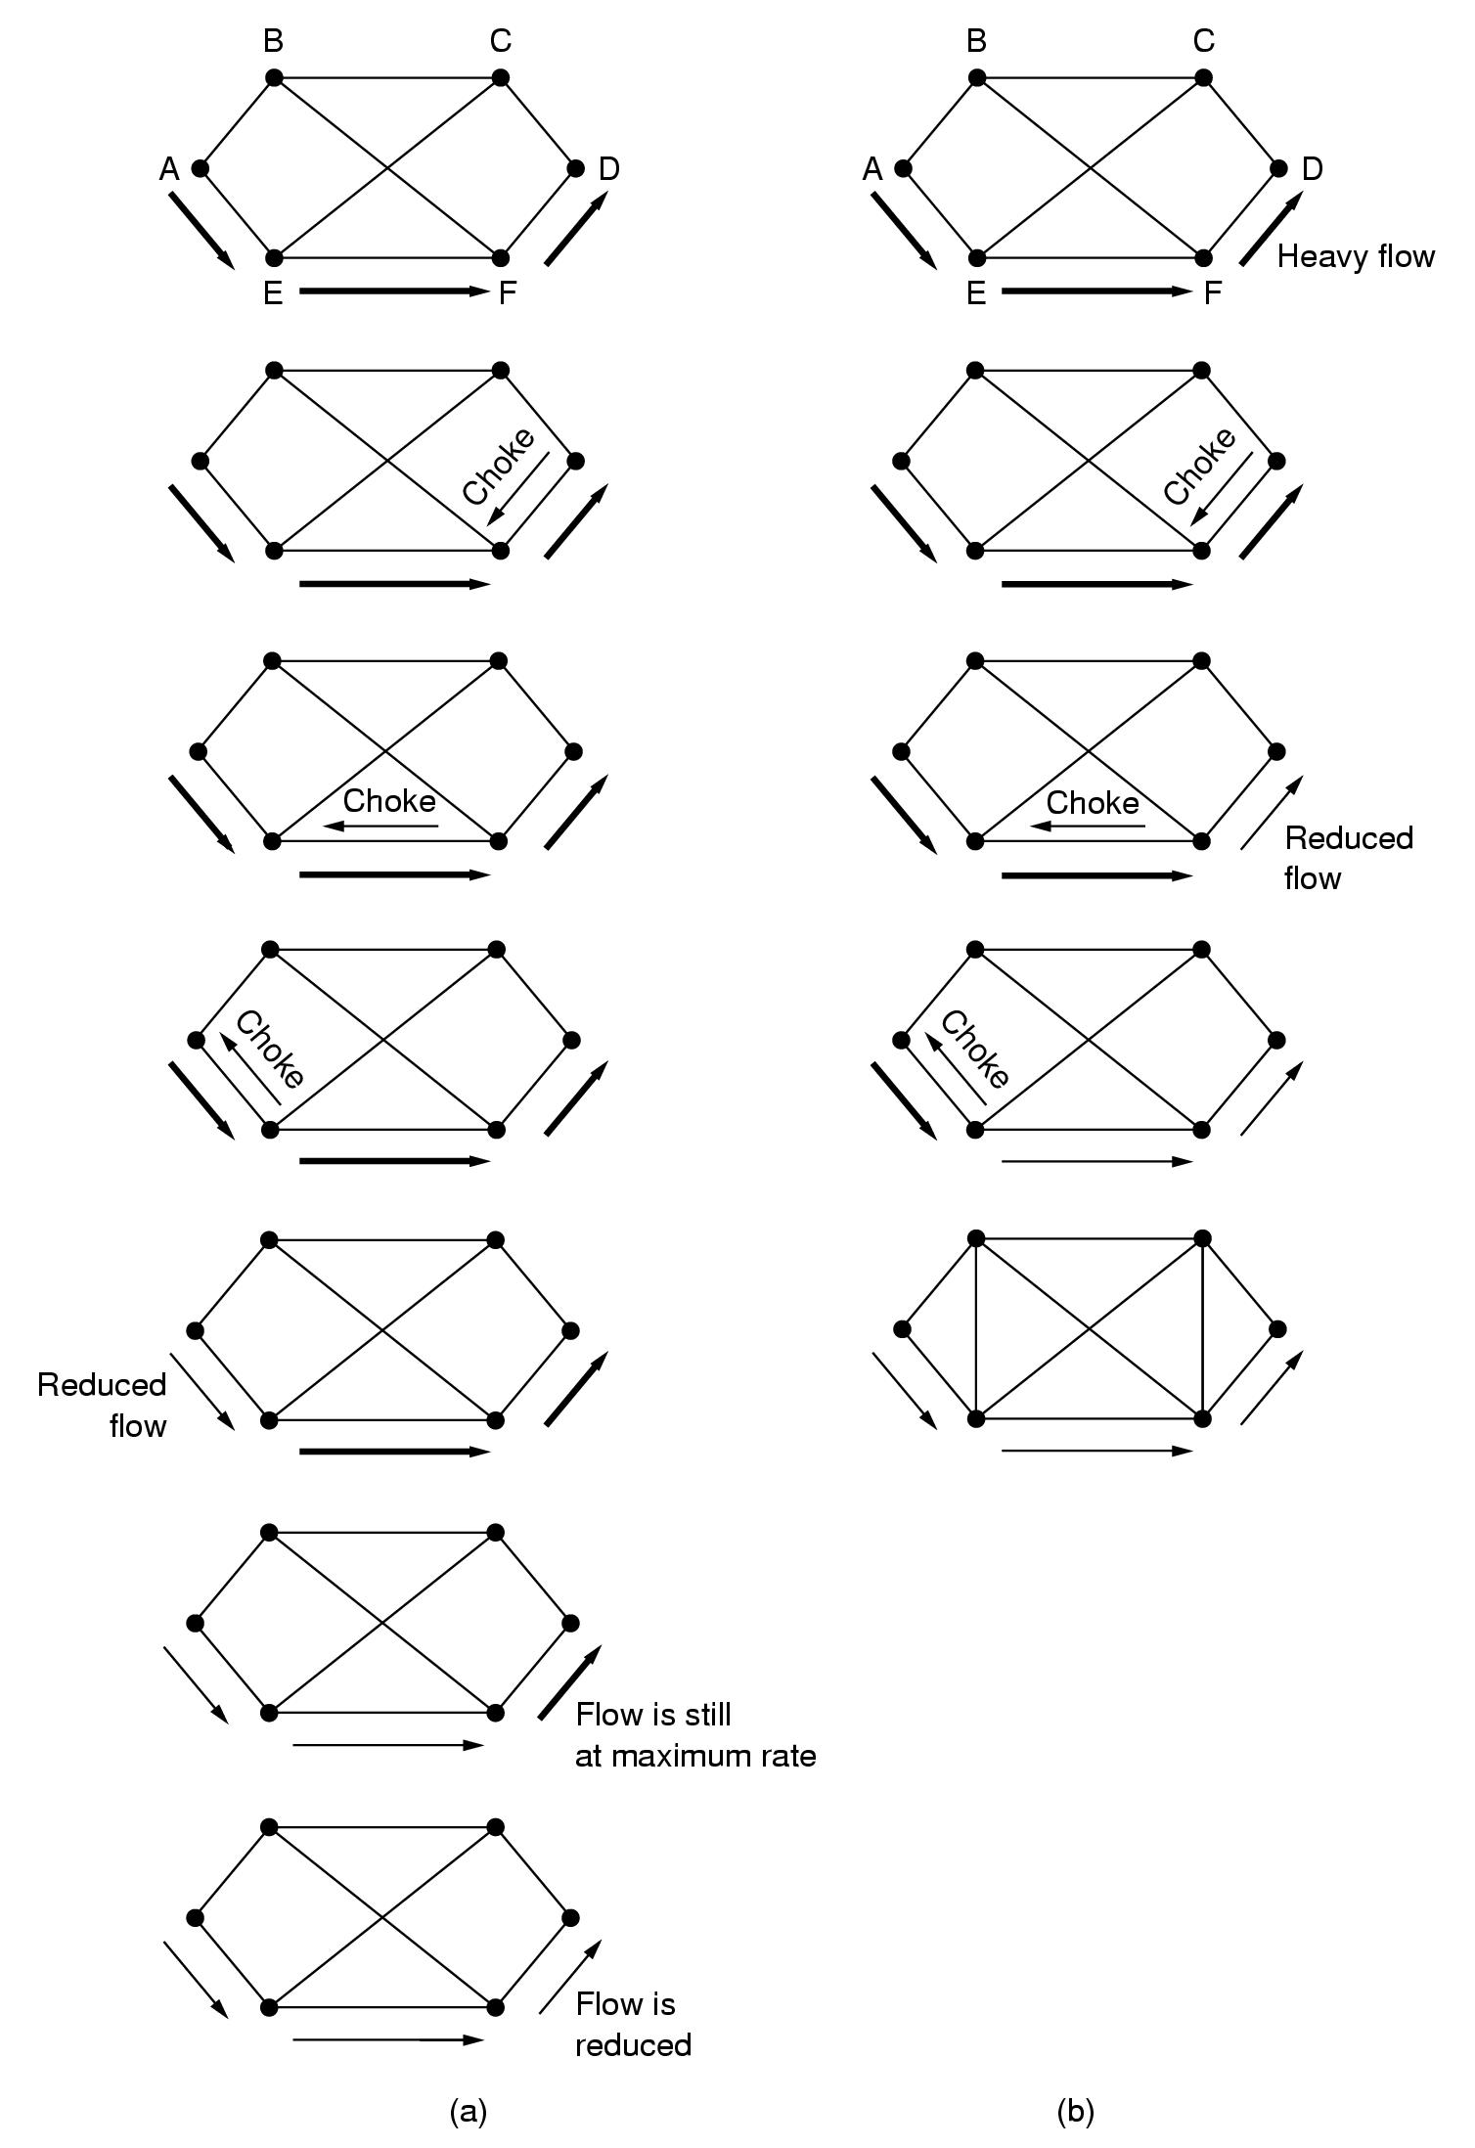
Source based approach
Choke packets:
  Example showing slow reaction
  Solution: Hop-by-Hop choke packets
Network layer - congestion

Slide 66
Hop-by-Hop Choke Packets
Over long distances or at high speeds choke packets are not very effective.
A more efficient method is to send to choke packets hop-by-hop.
This requires each hop to reduce its transmission even before the choke packet arrive at the source.

Slide 67
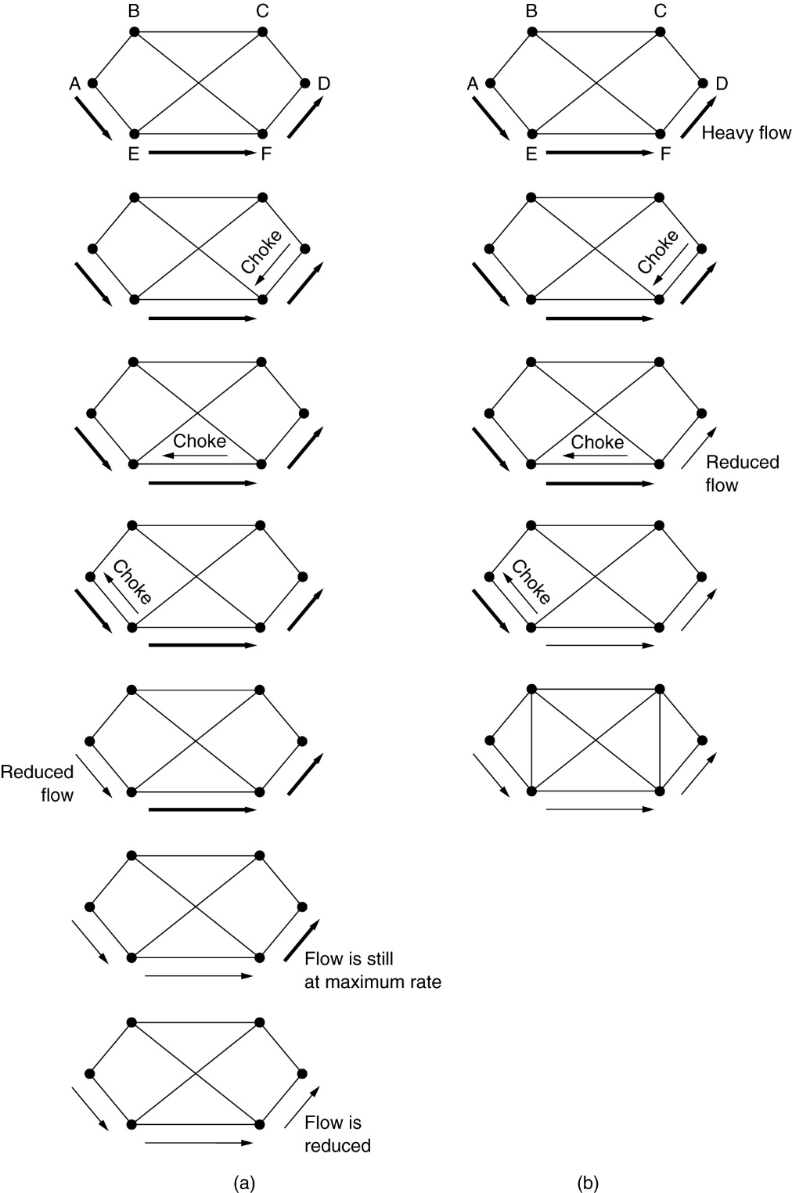
Hop-by-Hop Choke Packets
(a) A choke packet that affects only the source.
(b) A choke packet that affects each hop it passes through.

Slide 68
Load Shedding
When buffers become full, routers simply discard packets.
Which packet is chosen to be the victim depends on the application and on the error strategy used in the data link layer.
For a file transfer, for, e.g. cannot discard older packets since this will cause a gap in the received data.
For real-time voice or video it is probably better to
throw away old data and keep new packets.
Get the application to mark packets with discard priority.

Slide 69
Load shedding
Throw away packets that cannot be handled!!
Packet selection?
  Random
  Based on application
    File transfer: discard new packet
    Multimedia: discard old packet
  Let sender indicate importance of packets
    Low, high priority
    Incentive to mark a packet with low priority
      Price
      Allow hosts to exceed agreed upon limits
Random early detection …
Network layer - congestion

Slide 70
Load shedding
Throw away packets that cannot be handled!!
Packet selection?
Random early detection
  Discard packets before all buffer space is exhausted
  Routers maintain running average of queue lengths
  Select at random a packet
  Inform source?
    Send choke packet? ➔ more load!!
    No reporting
  When does it work?
    Source slows down when packets are lost
Network layer - congestion

Slide 71
Random Early Discard (RED)
This is a proactive approach in which the router discards one or more packets before the buffer becomes completely full.
Each time a packet arrives, the RED algorithm computes the average queue length, avg.
If avg is lower than some lower threshold, congestion is assumed to be minimal or non-existent and the packet is queued.

Slide 72
RED, cont.
If avg is greater than some upper threshold, congestion is assumed to be serious and the packet is discarded.
If avg is between the two thresholds, this might indicate the onset of congestion. The probability of congestion is then calculated.

Slide 73
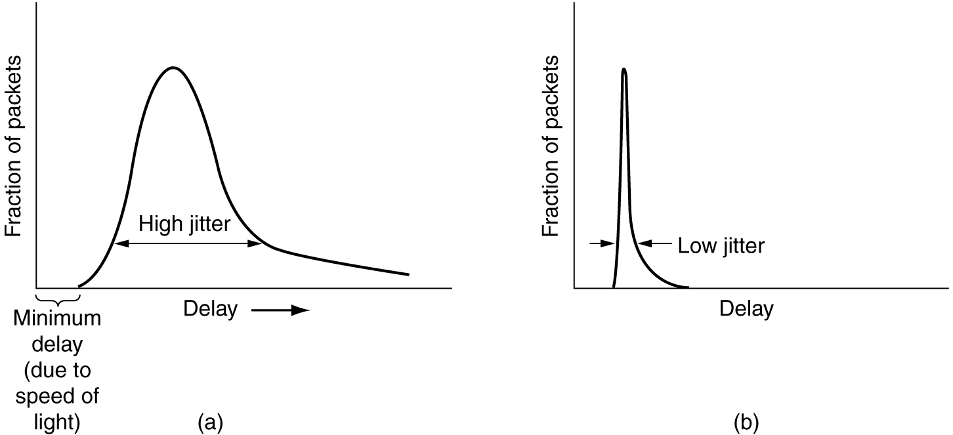
Congestion: jitter control
Important for audio and video applications?
  not delay
  variance of delay
Network layer - congestion

Slide 74
Congestion: jitter control
Jitter = variation in packet delay
Compute feasible mean value for delay
  compute expected transit time for each hop
  router checks to see if packet is
    behind
    ahead schedule
  behind: forward packet asap
  ahead: hold back packet to get it on schedule again
Buffering? Depends on characteristics:
  Video on demand: ok
  Videoconferencing: nok
Network layer - congestion

Slide 75
Traffic Shaping
Another method of congestion control is to “shape” the traffic before it enters the network.
Traffic shaping controls the rate at which packets are sent (not just how many). Used in ATM and Integrated Services networks.
At connection set-up time, the sender and carrier negotiate a traffic pattern (shape).
Two traffic shaping algorithms are:
  Leaky Bucket
  Token Bucket

Slide 76
The Leaky Bucket Algorithm
The Leaky Bucket Algorithm used to control rate in a network. It is implemented as a single-server queue with constant service time. If the bucket (buffer) overflows then packets are discarded.

Slide 77
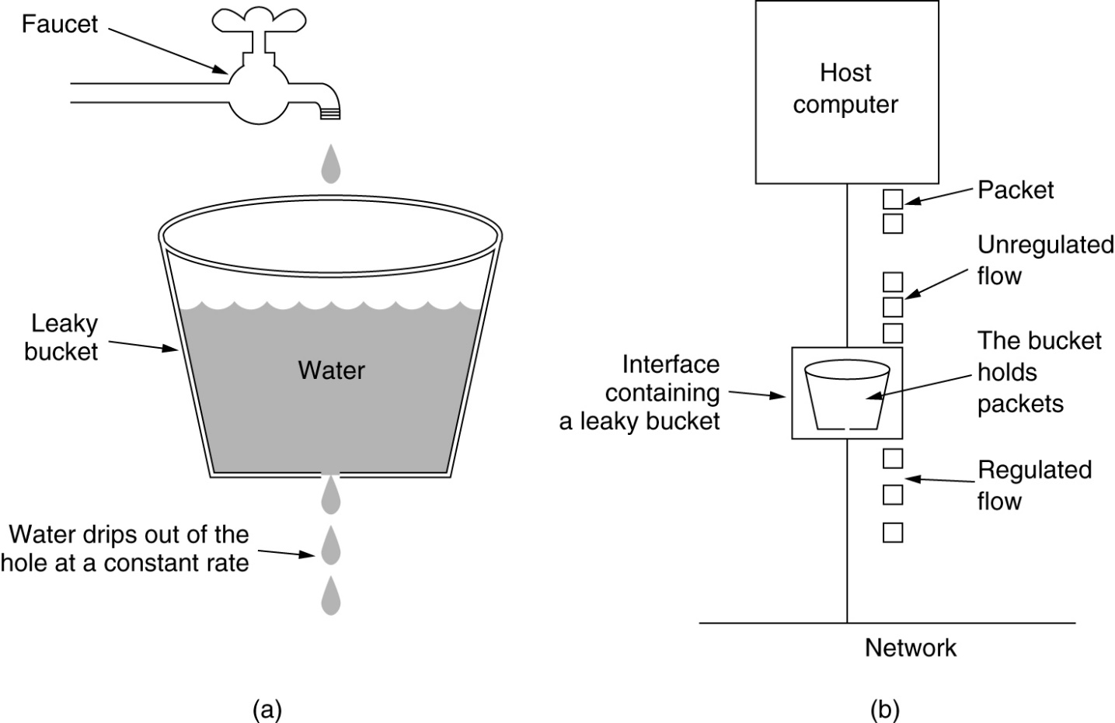
The Leaky Bucket Algorithm
(a) A leaky bucket with water. (b) a leaky bucket with packets.

Slide 78


Slide 79
Leaky Bucket Algorithm, cont.
The leaky bucket enforces a constant output rate (average rate) regardless of the burstiness of the input. Does nothing when input is idle.
The host injects one packet per clock tick onto the network. This results in a uniform flow of packets, smoothing out bursts and reducing congestion.
When packets are the same size (as in ATM cells), the one packet per tick is okay. For variable length packets though, it is better to allow a fixed number of bytes per tick. E.g. 1024 bytes per tick will allow one 1024-byte packet or two 512-byte packets or four 256-byte packets on 1 tick.

Slide 80

Leaky Bucket Implementation
Algorithm for variable-length packets:
  Initialize a counter to n at the tick of the clock
  If n is greater than the size of the packet, send packet and decrement the counter by the packet size. Repeat this step until n is smaller than the packet size
  Reset the counter and go to step 1

Slide 81
Example
200 | 700 | 500 | 450 | 400 | 200
Let n=1000 and assume that the queue contains packets of variable size.
1. n>front of queue
1000>200(true)
Therefore n=1000-200=800
Packet size of 200 is sent to the network.
2. Now the Queue is 200 700 500 450 400
800>400(front of queue) so 800-400=400
Packet size of 400 is sent
3. Now the queue becomes 200 700 500 450
400< 450 i.e the front of queue is greater than current ‘n’ value
Therefore packet size 450 can not sent. The procedure is stopped and we initialize n=1000 on another tick of clock.
This procedure is repeated until all the packets are sent to the network.

Slide 82
Token Bucket Algorithm
In contrast to the LB, the Token Bucket Algorithm, allows the output rate to vary, depending on the size of the burst.
In the TB algorithm, the bucket holds tokens. To transmit a packet, the host must capture and destroy one token.
Tokens are generated by a clock at the rate of one token every Δt sec.
Idle hosts can capture and save up tokens (up to the max. size of the bucket) in order to send larger bursts later.

Slide 83
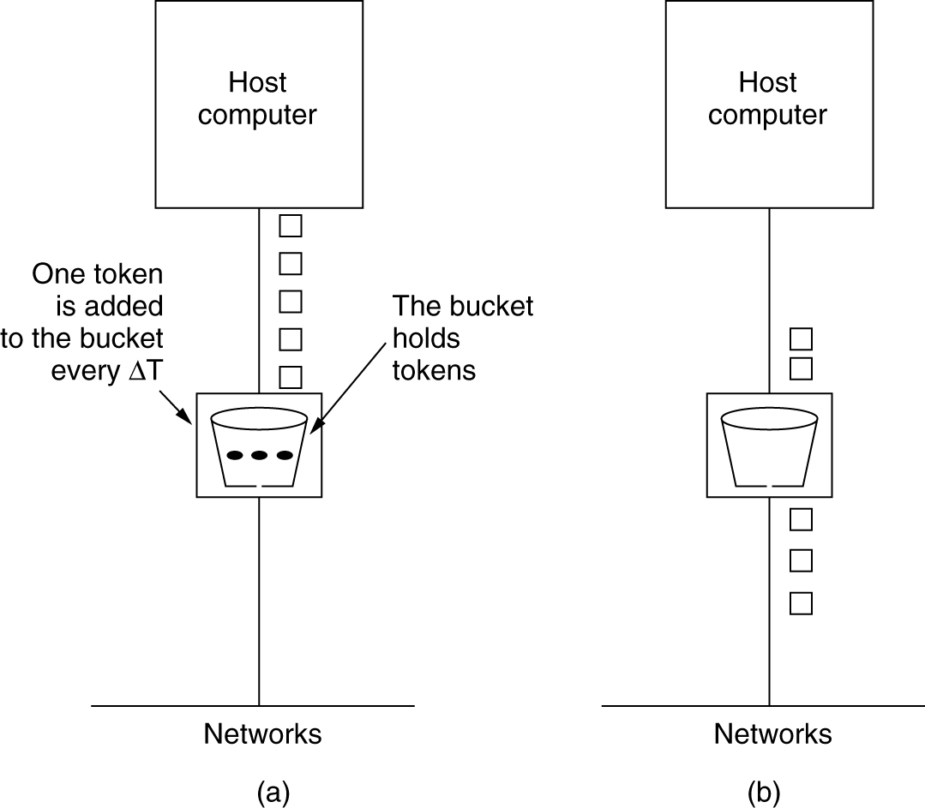
The Token Bucket Algorithm
5-34
(a) Before. (b) After.

Slide 84

Token Bucket
The token bucket allows bursty traffic at a regulated maximum rate.
Token bucket + leaky bucket: leaky bucket after token bucket

Slide 85
Token Bucket Algorithm:
A token is added at every Δt time.
The bucket can hold atmost b-tokens. If a token arrive when the bucket is full it is discarded.
When a packet has ‘m’ bytes arrived ‘m’ tokens are removed from the bucket and the packet is sent to the network
If less than ‘n’ tokens are available no tokens are removed from the bucket and the packet is considered to be non-conformant.
The non-conformant packet may be enqueued for subsequent transmission when sufficient tokens have been accumulated in bucket.

Slide 86
Leaky Bucket vs Token Bucket
LB discards packets; TB does not. TB discards tokens.
With TB, a packet can only be transmitted if there are enough tokens to cover its length in bytes.
LB sends packets at an average rate. TB allows for large bursts to be sent faster by speeding up the output.
TB allows saving up tokens (permissions) to send large bursts. LB does not allow saving.

Slide 87
21-1 ADDRESS MAPPING
The delivery of a packet to a host or a router requires two levels of addressing: logical and physical. We need to be able to map a logical address to its corresponding physical address and vice versa. This can be done by using either static or dynamic mapping.
Protocols Used for Mapping
Address Resolution Protocol (ARP)
Reverse Address Resolution Protocol (RARP)
Dynamic Host Configuration Protocol (DHCP)
21.<number>

Slide 88
Address Resolution Protocol
Internet is made of a combination of physical networks connected by internetworking devices such as routers
Hosts and routers are recognized at the network level by their logical IP addresses
Packets pass through physical networks to reach these hosts and routers
At the physical level, the hosts and routers are recognized by their physical addresses
ARP is the protocol used to map IP address to MAC address.
View ARP cache (Command prompt): arp –a

Slide 89

ARP operation
21.<number>

Slide 90
Performance: Cache Memory
Using ARP is inefficient if system A needs to broadcast an ARP request for each IP packet it needs to send to system B
ARP can be useful if the ARP reply is cached (kept in cache memory)
A system that receives ARP reply stores the mapping in cache memory and keep it for 20 to 30 minutes unless there is no space in the cache.
21.<number>

Slide 91

ARP PACKET FORMAT
21.<number>

Slide 92
ARP Packet
Hardware type: define the type of the network on which ARP is running. Ethernet is given type 1.
Protocol Type: define the protocol. 0800 for IPv4
Hardware length: define the length of the physical address in bytes. Ethernet the value is 6.
Protocol Length: define the length of the logical address in bytes. For IPv4 protocol the value is 4.
Operation: define the type of packets. ARP request (1) or ARP reply (2).
Sender hardware address: the physical address of the sender.
Sender protocol address: the IP address of the sender
Target hardware address: the physical address of the receiver.
Target protocol address: the IP address of the receiver.
21.<number>

Slide 93
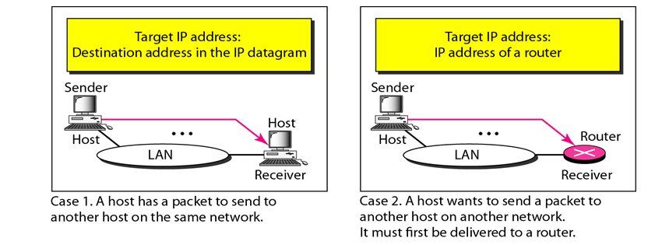
ARP FOUR CASES
21.<number>

Slide 94
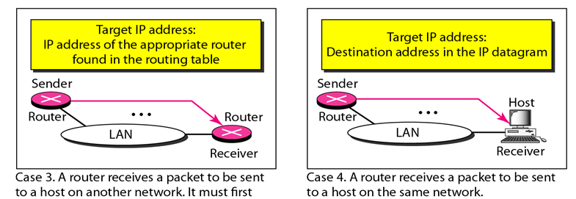
ARP FOUR CASES
be delivered to the appropriate router.
21.<number>

Slide 95

Note
An ARP request is broadcast;
an ARP reply is unicast.
21.<number>

Slide 96

Figure 21.6 Proxy ARP
A proxy ARP is an ARP that acts on behalf of a set of hosts.
21.<number>

Slide 97
Reverse Address Resolution Protocol (RARP)
Finds the logical address for a machine that knows only its physical address.
To create an IP datagram, a host or a router needs to know its own IP address or addresses.
A RARP request is created and broadcast on the local network.
The requesting machine must be running a RARP client program; the responding machine must be running a RARP server program.
There is a serious problem with RARP: Broadcasting is done at the data link layer.
This means that if an administrator has several networks or several subnets, it needs to assign a RARP server for each network or subnet.
21.<number>

Slide 98
Note
DHCP provides static and dynamic address allocation that can be
manual or automatic.
21.<number>

Slide 99
DHCP
Static Address Allocation: In this capacity DHCP acts as BOOTP does. So, A host running the BOOTP client can request a static address from a DHCP server. A DHCP server has a database that statically binds physical addresses to IP addresses.
Dynamic Address Allocation: DHCP has a second database with a pool of available IP addresses. When a DHCP client requests a temporary IP address, the DHCP server goes to the pool of available (unused) IP address and assigns an IP address for a negotiable period of time.
Command prompt: ipconfig/all, ipconfig/release, ipcnfig/renew.
21.<number>

Slide 100
Internet Control Message Protocol
ICMP always reports error messages to the original source.
Types of Messages
1.Error reporting messages
2.Query messages
21.<number>

Slide 101
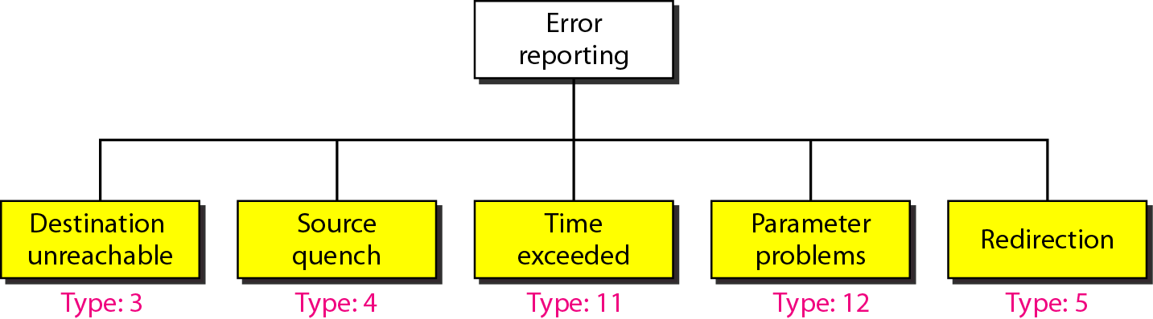
Figure 21.9 Error-reporting messages
21.<number>

Slide 102
Note
Important points about ICMP error messages:
❏ No ICMP error message will be generated in
response to a datagram carrying an ICMP error
message.
❏ No ICMP error message will be generated for a
fragmented datagram that is not the first fragment.
❏ No ICMP error message will be generated for a
datagram having a multicast address.
❏ No ICMP error message will be generated for a
datagram having a special address such as
127.0.0.0 or 0.0.0.0.
21.<number>

Slide 103
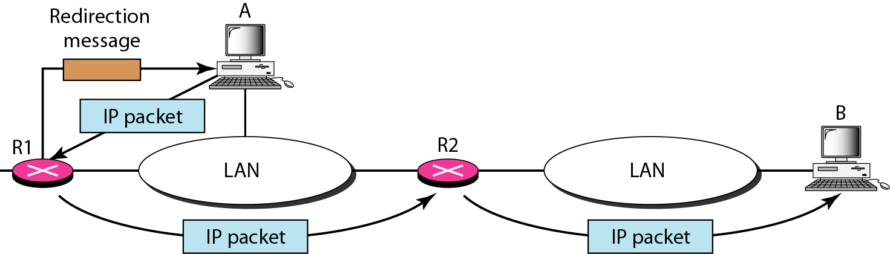
Figure 21.11 Redirection concept
21.<number>

Slide 104

Figure 21.12 Query messages
21.<number>

Slide 105
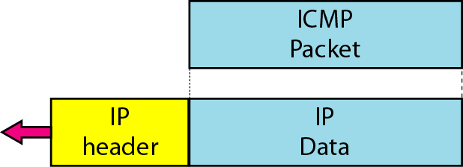
Figure 21.13 Encapsulation of ICMP query messages
De-bugging tools:
1.Ping
2.tracert
21.<number>

